Slide 1
SOAR
Innovation Insight for Security Orchestration, Automation and Response
Notes:
Enterprises are striving to keep up with the current threat landscape with too many manual processes, while struggling with a lack of resources, skills and budgets. Security and risk management leaders
should determine which SOAR tools improve security operations efficiency, quality and efficacy.

Slide 2
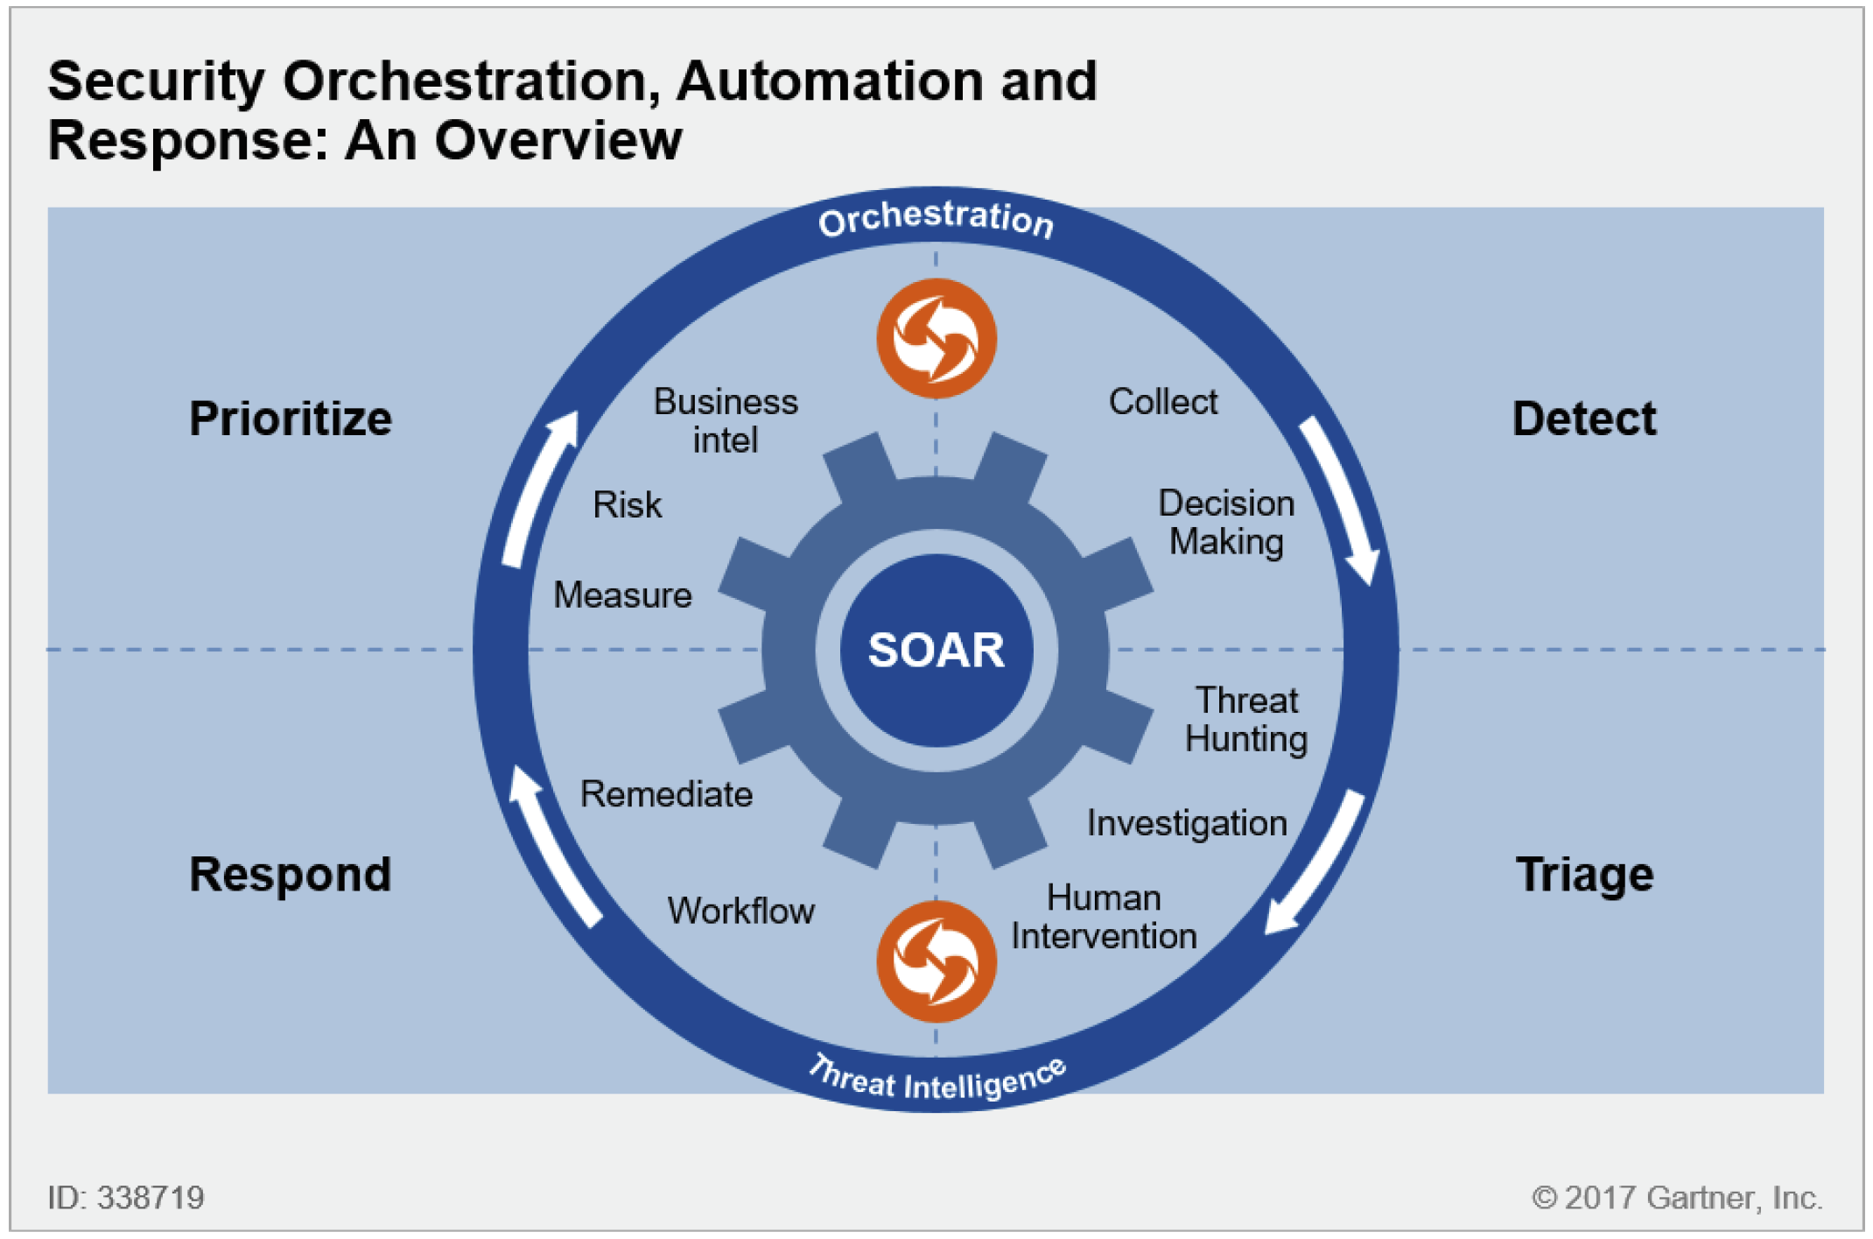
SOAR
Notes:
Definition
Gartner defines security orchestration, automation and response, or SOAR, as technologies that enable organizations to collect security threats data and alerts from different sources, where incident
analysis and triage can be performed leveraging a combination of human and machine power to help define, prioritize and drive standardized incident response activities according to a standard workflow.
SOAR tools allow an organization to define incident analysis and response procedures (aka plays in a security operations playbook) in a digital workflow format, such that a range of machine-driven
activities can be automated.

Slide 3
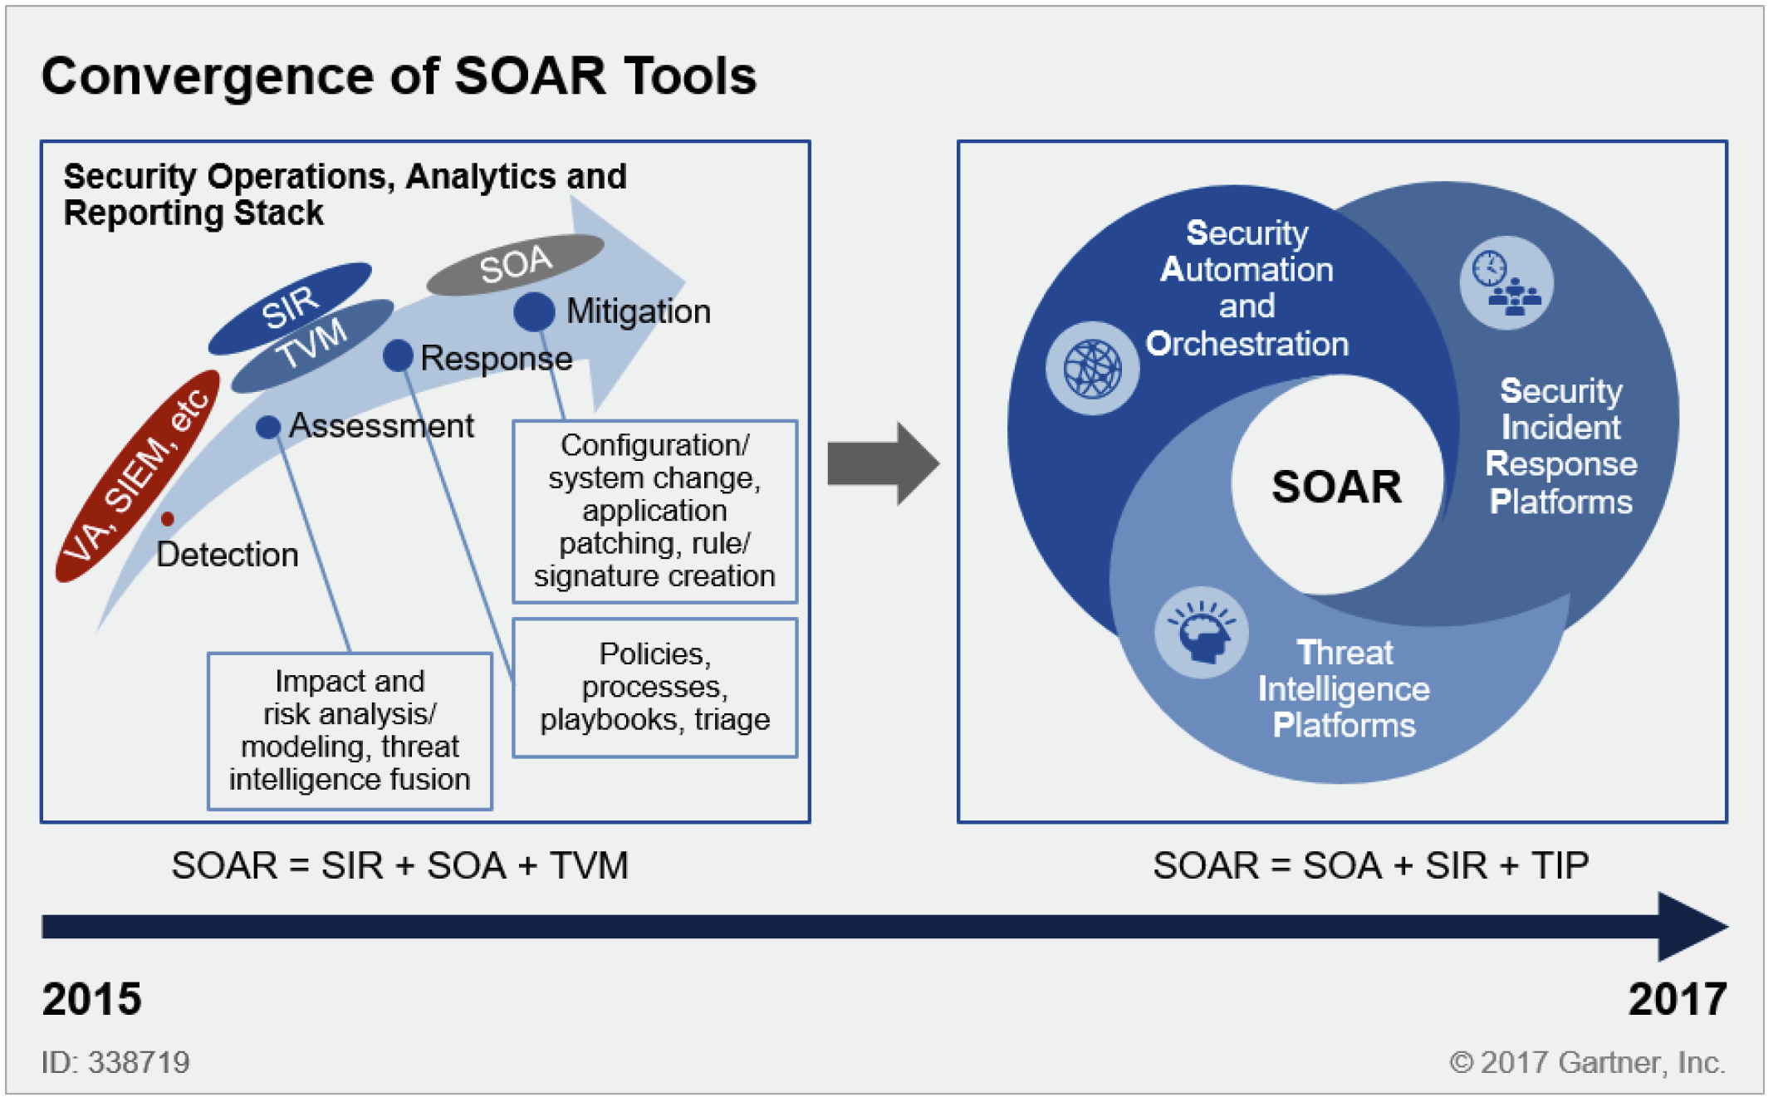
The Evolution

Slide 4
Functional Components
Orchestration
Automation
Incident management and collaboration
Dashboards and reporting
Notes:
SOAR can be described by the different functions and activities associated with its role within the SOC, and by its role with managing the life cycle of incident and security operations:
Orchestration — How different technologies (both security-specific and non-security-specific) are integrated to work together
Automation — How to make machines do task-oriented "human work"
Incident management and collaboration — End-to-end management of an incident by people
Dashboards and reporting — Visualizations and capabilities for collecting and reporting on metrics and other information

Slide 5
What SOAR is not
Governance, risk and compliance (GRC)
SIEM
User and entity behavior analytics (UEBA)
Threat and vulnerability management
Notes:
What SOAR is not:
Governance, risk and compliance (GRC), where the focus is on managing adherence to compliance frameworks, often based on controls. Gartner has evolved GRC to be called Integrated Risk
Management (IRM) now to include both IT risk management and Audit and Risk management.
SIEM, which provides reliable log ingestion and storage at scale, as well as normalization and correlation of events for real-time monitoring and the automated detection of security incidents.
User and entity behavior analytics (UEBA) or advanced threat detection, which are focused on behavioral and network analysis or the detection of indicators of compromise.
Threat and vulnerability management, which provides awareness for the types of threats facing an organization. TVM is focused on identifying, prioritizing and remediating security weaknesses based on
potential risk and impact of vulnerabilities.

Slide 6
Drivers for SOAR
Staff shortage
The explosion of unattended alerts from other security solutions
Threats becoming more destructive
The need to better understand the intersection of your environment with the prevailing threat landscape
Notes:
Drivers for SOAR include:
Staff shortage: Due to staff shortages in security operations (see "Adapt Your Traditional Staffing Practices for Cybersecurity" ), there is a growing need to automate, streamline workflows and orchestrate
security tasks. Also, the ability to be able to demonstrate to management the organization's ability to reduce the impact of inevitable incidents is ever-present.
The explosion of unattended alerts from other security solutions: The process of determining whether a specific alert deserves attention requires querying many data sources to triage.
Threats becoming more destructive: Threats destroying data, the disclosure of intellectual property and monetary extortion require a rapid, continuous response with fewer mistakes and fewer manual
steps.
The need to better understand the intersection of your environment with the prevailing threat landscape: A large number of security controls on the market today benefit from threat intelligence. SOAR
tools allow for the central collection, aggregation, deduplication, enrichment of existing data with threat intelligence, and, importantly, converting intelligence into action.

Slide 7
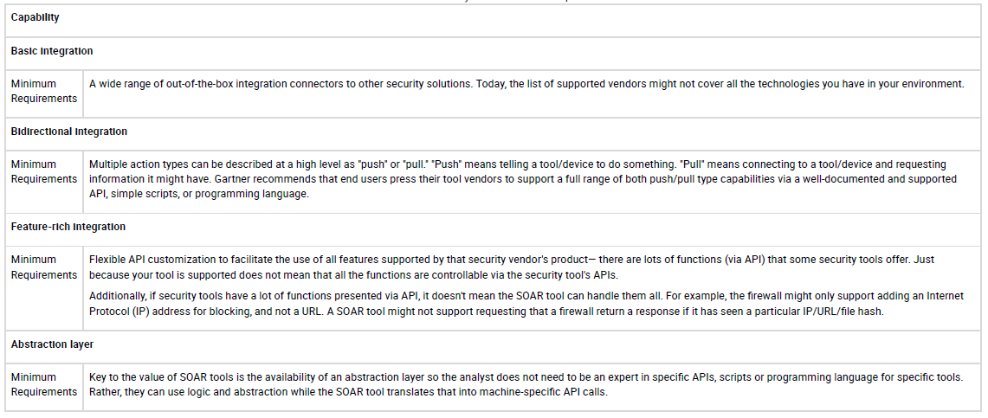
Orchestration
Notes:
Orchestration
Gartner sees orchestration as the ability to coordinate informed decision making, and formalize and automate responsive actions based on measurement of the risk posture and the state of an
environment. SOAR orchestrates the collection of alerts, assesses their criticality, coordinates incident response and remediation, and measures the whole process. One example is the response to reported
email that may be suspicious. The end user reports to the SOC a suspicious email, which would require an investigation to confirm whether sender has a bad reputation (through threat intelligence). The use
of DNS tools would confirm origin of the email. The analyst would have to extract any hyperlink from the email to validate through URL reputation, or to detonate the link through a secure environment or to
run attachments on a sandbox. This process would be done for every reported suspicious email to transform it to an incident. Orchestration provides enough information (automating the data collection
into a single place) to help the analyst to review and decide if the situation is suspicious. If the investigation confirms an incident, it would initiate the workflow (playbook) to respond to the incident.
Integration with the email system, sandbox and ticket system would provide an automated process to look at the email system to find all messages with a suspicious link or attachment. Then, the system
would quarantine email that was sent to other users, while waiting for the decision of deleting or allowing access to quarantined email. Think of the process as conducting an orchestra: a conductor
controls multiple musical instruments to produce not just noise, but music. Today, security teams have the problem of having to pick up and play each instrument, but they can't play many instruments at
the same time. It takes time to pick and up put down each instrument. In the world of security operations, this is called "context switching," and it costs teams time (dead time) to orchestrate and perform
each step in a process.

Slide 8
Automation
Notes:
Some vendors use the terms "automation" and "orchestration" interchangeably as synonyms, although they are not the same concept.
Automation is a subset of orchestration. It allows multiple tasks (commonly called "playbooks") to execute numerous tasks on either partial or full elements of a security process. The security operations
teams can build out relatively sophisticated processes with automation to improve accuracy and time to action. For example, a SIEM could check if an IP addresses has been seen, or block an IP address on
a firewall or intrusion detection and prevention system (IDPS), or a URL on a secure web gateway. It can then create a ticket in your ticketing system or connect to Windows Active Directory, and lock or reset
the password for a user's account.
Table 2 outlines the main requirements for auto

Slide 9
Incident Management and Collaboration ALERT PROCESSING AND TRIAGE JOURNALING AND EVIDENTIARY SUPPORT
Notes:
Incident Management and Collaboration
Another function of the SOC that the SOAR tools make more efficient is the management of the incidents and the improved collaboration between team members working together on incidents.
This major function is complex. It deals with the life cycle of the incident from the moment an alert is generated, to the initial triage, to the validation of true/false positive, to the hunting and finally the
remediation. To carry on this life cycle, the SOC team needs to collaborate and use an efficient collaboration framework, while threat intelligence becomes an integral part of the data points for this process.
Incident management and collaboration comprises several activities, described in the following sections.
ALERT PROCESSING AND TRIAGE
Two key metrics for information security are the mean time to detect (MTTD) and mean time to respond (MTTR). To accomplish an efficient incident response, SOC analysts need a better way to gather
supporting information from a wide range of sources to assess and determine which alerts are real incidents. SOAR technologies gather and analyze various security data. The data is then made available
and consumable by different stakeholders and for use cases beyond the original purpose. Triage will ensure that incidents based on information collected from other sources will be prioritized based on
criticality and level of impact.
Event collection is commonly achieved through integration with a SIEM platform. Some solutions can automatically generate incidents for investigation. This removes the need to have a human first notice
an incident and then invoke a manual step to create the instance of that incident. A key advantage of deploying SOAR technology is the first pass on alerts to reduce the noise or reduce the subsequent
workload of analysts.
JOURNALING AND EVIDENTIARY SUPPORT
Some SOAR solutions can record information about actions taken, including details of the action itself, the person taking the action and when it occurred. Such journaling can be extremely useful in complex
incidents where the following characteristics may apply:
There are questions as to whether apparently separate activity may or may not be linked to a broader operation by the adversary.
The incident takes place over an extended period, and so records of activity become a reliable corporate memory.
There are multiple people working on an incident or action
Regulations and other mandates require reports to be produced
Table 3 outlines the main requirements for journaling and evidentiary support in SOAR tools.

Slide 10
CASE MANAGEMENT AND WORKFLOW
Notes:
Two forms of security operations automation are often encountered: one focusing on automating the workflow and policy execution around security operations; the other automating the configuration of
compensating controls and threat countermeasure implementation. To fully automate or semiautomate these tasks, solutions frequently provide libraries of common and best-practice playbooks, scripts
and connectors covering remediation and response actions and processes. These should support the formalization, enforcement and gathering of key performance indicators of security policies. Custom
workflow implementation must also be supported.
One of the biggest challenges in IT security operations capturing and retaining this "group knowledge" that exists within environments. Security operations staff often have an overabundance of notes,
scripts and documents that describe in extreme detail how to perform a specific task. Additionally, these are often kept in an analyst's own head, and not fully documented. One of the hidden benefits of
SOAR is the ability to codify tribal knowledge into tools, so it can be captured and used by many others. Gartner inquiries

Slide 11
ANALYTICS AND INCIDENT INVESTIGATION SUPPORT
Notes:
Proper investigation requires centralized tool that helps SOC analysts to quickly identify threats or incidents. During the process of investigation an ability to store artifacts will help through the identification
and classification of threats. Those artifacts can also be used later to support further auditing demonstrating chronologically actions and data collected that resulted in a final response. The use of
analytics will improve the reduction of false positive based on historical data and determination of level of risk assigned to incidents that will conduct the prioritization among many incidents.
Table 5 outlines the main requirements for analytics support in SOAR tools.

Slide 12
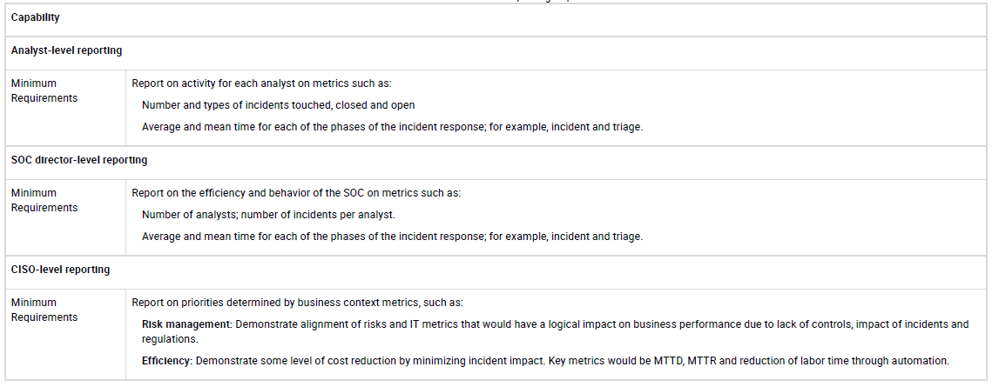
MANAGEMENT OF THREAT INTELLIGENCE
Notes:
MANAGEMENT OF THREAT INTELLIGENCE
Threat intelligence is becoming a significant resource for detecting, diagnosing and treating imminent or active threats (see "Market Guide for Security Threat Intelligence Products and Services" ). Most
SOAR tools, like many others in the security market today, include various forms of threat intelligence integration for this purpose. Some are built in, and others are able to be augmented by tools like a TIP.
SOAR tools, however, allow not just themselves, but other deployed technology, to make use of third-party sources of intelligence. This can come in various forms: open source; industry leaders; coordinated
response organizations, such as Computer Emergency Response Teams (CERTs); and a large number of commercial threat intelligence providers.
TIPs specialize in enabling intelligence-led initiatives in a security program as their base feature set. Today, they offer a sophisticated method for collecting and aggregating threat intelligence for use in
security operations. They also have connections to existing tools, such as SIEM, firewall, secure web gateway (SWG), IDPS and endpoint detection and response (EDR).
Dashboards and Reporting
SOAR tools are expected to generate reports and dashboards for at least three classes of persona: analyst, SOC director and chief information security officer (CISO).
Because SOAR tools orchestrate incident response, have bidirectional communication with many other tools in the organization, and empower analysts, they are generating and accessing a lot of very
valuable metrics that can be used for several types of reporting.
Table 6 outlines the main requirements for dashboards and reporting in SOAR tools.

Slide 13
Benefits and Uses
Prioritizing security operations activities
Formalizing triage and Incident response
Automating containment workflows
Notes:
Benefits and Uses
SOAR supports multiple activities for security operations decision making, such as:
Prioritizing security operations activities: Prioritized and managed remediation based on business context is the main target of security operations.
Formalizing triage and incident response: Security operations teams must be consistent in their response to incident and threats. They must also follow best practices, provide an audit trail and be
measurable against business objectives.
Automating containment workflows: This offers SOC teams the ability to automate most of the activities to isolate/contain security incidents to be conceived by the human decision for the final steps to
finalize the incident response.
Adoption Rate
Gartner estimates that today less than 1% of large enterprises currently use SOAR technologies. Higher adoption will be driven by pressing staff shortages, a relentless threat landscape, increasing internal
and externally mandated compliance rules (such as mandatory breach disclosure), and a steady growth of APIs in security products. Also, the potential market for SOAR today is large organizations, with
managed security service providers (MSSPs) as the primary target. Over time, smaller teams facing the same security threat problems will also begin to adopt SOAR tools. The ongoing skills and expertise
shortage and the increasing escalation in threat activity will hasten the move to orchestration and automation of SOC activities.

Slide 14
Risks
Market direction
Limited integration value
Notes:
Risks
Key risks for implementing SOAR include:
Market direction: In the longer term, adjacent technologies that are much larger and also focus on security operations (such as SIEM or other threat-focused vendors/segments) are likely to add SOARlike
capabilities. This will be sped up by acquisitions of SOAR tool vendors (for example, IBM acquiring Resilient Systems; Microsoft acquiring Hexadite; FireEye acquiring Invotas; ServiceNOW acquiring
BrightPoint Security).
Limited integration value: Clients will not be able to leverage a SOAR tool if they lack a minimum set of security solutions in place to provide enough information to make a decision nor automating
security tasks. For example, SIEM is often a key piece of technology for the use of SOAR tools due to its complimentary nature. Today, SOAR is most viable for Type A and Type B organizations.
Budget: Clients that are budget-constrained need to juggle conflicting needs

Slide 15
Final Recommendations
Improve Security Operations Efficiency and Efficacy
Product Selection
Better Prioritize the Focus of Security Operations
Don't "Boil the Ocean" — Focus on Critical Security Processes and Use Tools Such as SOAR to Evolve From There
Notes:
IT security leaders should consider SOAR tools in their security operations to meet the following goals.
Improve Security Operations Efficiency and Efficacy
SOAR tools offer a way to move through a task, from steps A to Z. For example, if a process takes an hour or two to perform, having a way to reduce that to 15 minutes offers a significant improvement in
productivity. This is beneficial because:
Performing the task faster equals better time to resolution. The longer an issue is left unaddressed, the worse it can become, leaving the organization in a potentially risky situation for longer periods of
time. Ransomware, for example, is a threat that can get exponentially worse with time.
Staff shortages are a critical issue for many organizations. The ability to handle processes more efficiently means that security analysts can spend less time with each incident and will thus be able to
handle more incidents, allowing response to more incidents despite fewer resources being available.
Automation and orchestration allow your tools to work together to solve issues, versus operating in isolation with no context, which requires a lot of manual work to perform required tasks.
Product Selection
Security and risk management leaders should favor SOAR solutions that:
Allow orchestration of a rich set of different security (and nonsecurity) technologies, with a focus on the specific solutions that are already deployed or about to be deployed in an organization.
Promote an easy integration of tools not included in the out-of-the-box integration list.
Offer the capability to easily code an organization's existing playbooks that the tool can then automate, either via an intuitive UI and/or via a simple script.
Optimize the collaboration of analysts in the SOC; for example, with a chat or IM framework that make analysts' communication more efficient, or with the ability to work together on complex cases.
Have a pricing cost that is aligned with the needs of the organization and that is predictable. Avoid pricing structures based on the volume of data managed by the tool, or based on the number of
playbooks that are run per month, as these metrics carry an automatic penalty for more frequent use of the solution.
Offer flexibility in the deployment and hosting of the solution, either in the cloud, on-premises or a hybrid of these, to accommodate organizations' security policies and privacy considerations, or
organizations' cloud-first initiatives.
Better Prioritize the Focus of Security Operations
Prioritization is perennially a key problem. Favor SOAR tools that can help select the top 10 things to be doing today if you have 100 you can potentially do. Efficiency will not fix poor prioritization. SOAR
tools can help with this by using external context, like threat intelligence, to help drive processes that have more context so that better decisions can be made in security operations. The goal is working
smarter, not harder.
Don't "Boil the Ocean" — Focus on Critical Security Processes and Use Tools Such as SOAR to Evolve From There
Security teams are regularly tasked with fixing all things, all the time, 24/7, everywhere — but with the same budget and staffing as last year. This is clearly untenable, yet is a persistent observation we have
with security operations teams in client inquiries. For security operations, we recommend focusing on executing well on key incident response processes,

Slide 16
Thank you.

